Slide 1
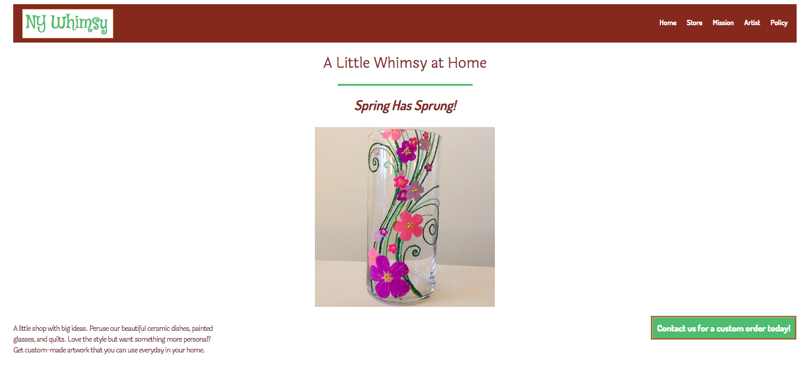
Unit 7
Mid-Term Assignment

Slide 2

Audience/Tone
Customers will primarily be visiting my site. My product will stand out because everything is hand-made and can be custom-made/made to order.
If I were speaking to the customer I would be professional and up-beat. I would be friendly and personal while making my dedication to my craft clear. I could translate that style digitally by keeping my site organized, consistent, and clear but involving intriguing visuals and creative fonts.
Teal and or tans best represent the product. Images that show off the product versatility best illustrate my message.

Slide 3
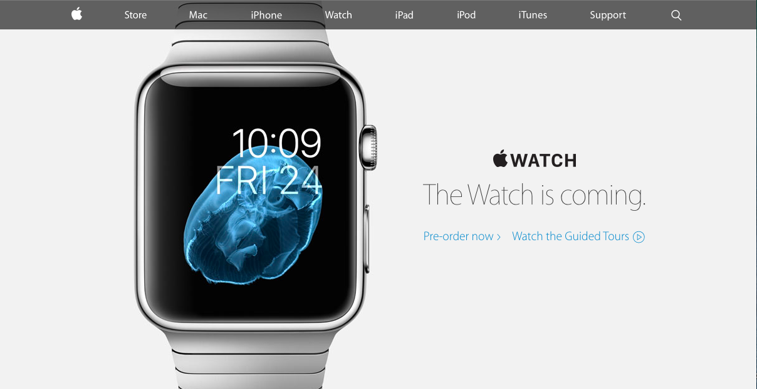
Inspiration
My site was most inspired by the Apple website. Since this is also the site for a store I chose to do what Apple does by keeping a clean, white background with a hero image in the center. The Apple site uses this hero image as the focus and generally changes it periodically to highlight their newest gadget for sale. I did the same by making my image one of the line’s seasonal products and changed the h2 to bring attention to the season as well.

Slide 4
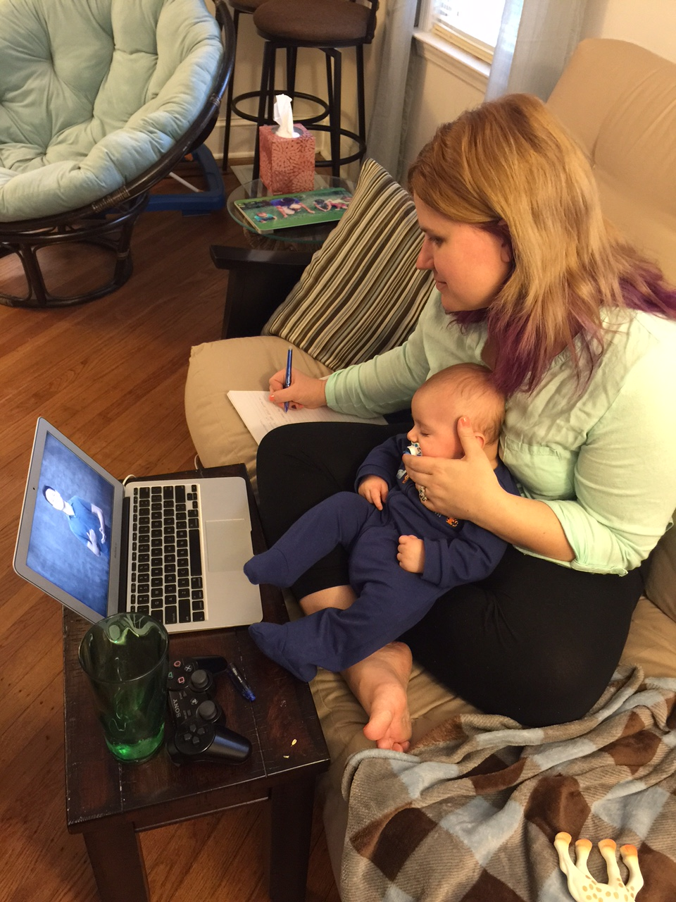
Props to Me!
First of all I worked on this project with a newborn on my lap 90% of the time so I feel good about getting it done and getting it just the way I want it.
I feel like I was able to play with most of the css elements that we learned in previous lessons and now feel really confident about using padding, borders, and margin. I didn’t used to really grasp the difference and now I’m a pro.
I did some Googling to help me do something that we didn’t learn in the class which is adjust the anchor in the html to open the link in a new tab rather than the current tab. That’s something you’d definitely want in place to keep people buying stuff on your site!

Slide 5
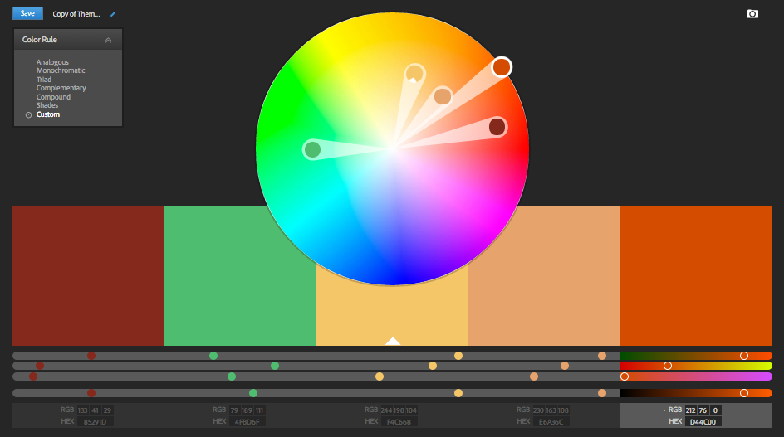
Tricky Design
I think coding is my strong point and design is my weaker area so I definitely struggled with it. My biggest issue was the colors and what should be what color. Font was easier because we learned where it’s best to use serifs and sans-serifs and I followed those guidelines for the most-part. I was also happy with the colors I picked but struggled with knowing how to spread out the colors and what colors should be used for each element. Let me know what you think!

Slide 6
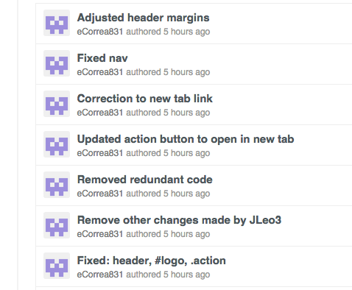
Success Story
When I was done putting my html document and css documents together and looked at the site for the first time there were a bunch of things that weren’t working. In particular, my header looked crazy and my action button didn’t look the way I wanted it to. It took a lot of Googling and playing around to get it all to work and it felt great once I figured out all of my miniscule errors that kept the code from executing the way I wanted.

Slide 7
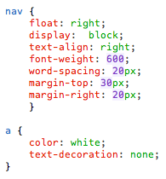
Tricky Development
When I wrote the css code for the nav I had many properties applied to the nav property including float, display, text-align, font-weight, word-spacing, and margins but I also had the color and the text-decoration set here and those two weren’t executing. I tried playing with the code in html and css and couldn’t get them to work finally I separated those two elements from the nav property and called them in the a property instead. I’m not sure why that worked and why they can’t be included under nav but I left it since it finally worked the way I wanted. Any ideas?

